Slide 1

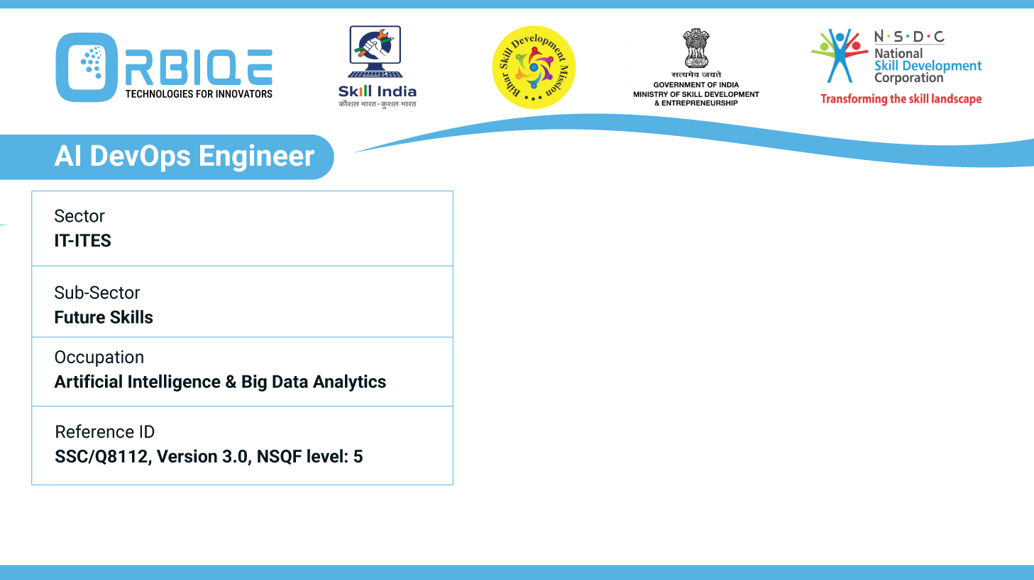
Name- Krishna Kant Dubey

Slide 2

Delegating Actions with Ansible

Slide 3
Agenda
Utilize Ansible’s delegation feature to delegate tasks to other hosts within playbooks
Define specific hosts or groups to perform delegated tasks, enhancing flexibility and scalability
Delegate actions based on specific conditions or requirements within the configuration management workflow

Slide 4
Utilize Ansible’s delegation feature to delegate tasks to other hosts within playbooks

Slide 5
Define specific hosts or groups to perform delegated tasks, enhancing flexibility and scalability

Slide 6
Delegate actions based on specific conditions or requirements within the configuration management workflow

Slide 7
Thank You

